Slide 1
PATIENT CASE SIMILARITY
PIP2001 Capstone Project
Final Review
Batch Number: CAI-G24
Under the Supervision of,
Dr. Mohammadi Akheela Khanum
Professor
School of Computer Science and Engineering
Presidency University
Roll Number | Student Name
20211CAI0062 | Pranav Ganesh
20211CAI0063 | Prerna Kakade
20211CAI0069 | Bhuvana V
20211CAI0085 | Nida Aiyman
Name of the Program: B.Tech
Name of the HoD: Dr. Zafar Ali Khan
Name of the Program Project Coordinator: Dr. Afroz Pasha
Name of the School Project Coordinators: Dr. Sampath A K / Dr. Abdul Khadar A / Mr. Md Ziaur Rahman

Slide 2
Introduction
Patient Case Similarity is used in healthcare systems, particularly in clinical decision support systems, to give similarity scores between the new and old patients.
In this project, we are comparing a new patient’s data with a historical patient. The data is gathered from electronic health records (EHRs) and various research papers.
This is done to identify similar patterns and predict the similarity score.
The main goal is to cluster patients based on heart diseases.
After which we will improve the diagnostic accuracy, predictive models and optimize the models.

Slide 3
Hardware/Software components
Hardware:-
Laptop (11th Gen Intel(R) Core(TM) i5-11320H @ 3.20GHz 2.50 GHz, 16 GB RAM)
Software:-
i. Operating System: Windows
ii. Programming Language: Python 3.7 or higher - The primary language for machine learning and deep learning development.
iii. Machine Learning Libraries:
•NumPy, Pandas: For data manipulation and analysis.
•Matplotlib, Seaborn: For data visualization.
iv. Google colab notebook and Visual Studio Code: For running interactive Python code and sharing results with the research team.
v. Git: For version control and collaboration.

Slide 4
Literature Review
Research Paper | Year | Advantages | Disadvantages
Use abstracted patient-specific features to assist an information-theoretic measurement to assess similarity between medical cases | 2008 | Improve case similarity measurement Integrate natural language processing (NLP) for feature abstraction | The study admits limitations and focuses on only four feature types and the lack of contextual information in weighing features. Future research should examine the impact of additional features and contextual factors on similarity measures to upgrade their suitability.
ii) Patient Similarity: Emerging Concepts in Systems and Precision Medicine | 2016 | The goal is to set the foundation for the integration of computational tools and data analytics to enhance personalized healthcare. The main focus is how patient similarity algorithms can improve medical decisions by grouping similar patients. | Data Difficulties Growth Challenges

Slide 5
Research Paper | Year | Advantages | Disadvantages
iii) Patient similarity for precision medicine: A systematic review | 2018 | The primary aim of this line of research is to improve clinical outcomes for individual patients through more precise treatment targeting by leveraging on genetic, biomarker, phenotypic, or psychosocial characteristics. That distinguish a given patient from others with similar clinical presentations | Limited Database Scope Lack of Real-World Application
iv) A patient-similarity-based model for diagnostic prediction | 2019 | To simulate the clinical reasoning of doctors, retrieve analogous patients of an index patient automatically and predict diagnoses by the similar/dissimilar patients. The main goal is to predict patient diagnoses by comparing the similarities between the clinical features of current patients and historical patient data. | Limited Dataset Size High Computational Costs

Slide 6
Research Paper | Year | Advantages | Disadvantages
v) Measurement and application of patient similarity in personalized predictive, modelling based on electronic medical records | 2019 | The main goal of this research was to create a new way to measure how similar patients are, based on the data from electronic medical records (EMRs). By measuring patient similarity, the study aimed to improve how we predict a patient’s health outcomes, specifically focusing on diabetes. | The study didn’t fully use all the available data when calculating patient similarity The models didn’t include specific exclusion criteria when choosing patients for the study.
vi) Measuring Patient Similarities via a Deep Architecture with Medical Concept Embedding | 2019 | Develop a framework to measure clinical similarities between patients based on EHRs. Preserve temporal information in patient data, which is often lost in existing models. | Loss of temporal information in existing methods: High dimensionality and sparsity

Slide 7
Research Paper | Year | Advantages | Disadvantages
vii) Patient-Case Similarity | 2020 | Develop a system to identify patients with similar medical histories. Improve decision-making processes in clinical settings using patient data. | Data Quality Dependency Complex Medical Cases
viii) Patient similarity: methods and applications | 2020 | Analyze and compute similarities between patients using electronic health records (EHRs), genetic, and other data. Improve predictive models in healthcare by integrating patient-specific data from various sources. | Information Loss Complexity in Implementation

Slide 8
Research Paper | Year | Advantages | Disadvantages
ix)Patient similarity analytics for explainable clinical risk prediction | 2021 | To develop an explainable and interpretable Clinical Risk Prediction Model (CRPM) by leveraging patient similarity analytics, specifically to improve explainability and interpretability. To use real-world data from electronic medical records of patients with type-2 diabetes, hypertension, and dyslipidemia in Singapore to develop and validate the patient similarity model​ | Incomplete Variable Set Static Data Usage
x)A Novel Patient Similarity Network (PSN) Framework Based on Multi-Model Deep Learning for Precision Medicine | 2022 | Utilizes multi-model deep learning to identify similarities among patients. This patient similarity network (PSN) approach aims to enhance precision medicine by combining multiple data types, such as clinical records, genetic information, and imaging data. | Data Heterogeneity and Dimensionality Limited Availability of Open Datasets

Slide 9
Research Paper | Year | Advantages | Disadvantages
xi) Deep Dynamic Patient Similarity Analysis: Model Development and Validation in ICU | 2022 | Develop a Novel Dynamic Patient Similarity Model Validate Model Using Clinical Tasks | Limited Clinical Application Computational Complexity
xii) Patient Case Similarity | 2024 | Improve healthcare analytics by leveraging data science techniques to enhance diagnostics, treatment recommendations, and patient care outcomes The system utilizes machine learning (ML) and natural language processing (NLP) to identify similarities between patient cases, enabling more personalized, data-driven medical interventions. | Prescription Recommendation Accuracy Scalability Concerns

Slide 10
Existing method Drawback
i. Use abstracted patient-specific features to assist an information-theoretic measurement to assess similarity between medical cases – 2008:-
The study only looks at four types of features and doesn't consider the context when weighing them. Future research should look at how adding more features and context can improve similarity measures
ii. Patient Similarity: Emerging Concepts in Systems and Precision Medicine – 2016:-
Complexity of algorithms – many of the proposed algorithms are not yet optimized for real-world clinical use due to their complexity and reliance on high-end computing infrastructure.
iii. Patient similarity for precision medicine: A systematic review – 2018:-
Lack of Deep Learning Exploration - The paper talks very little about deep learning, which is now important for analyzing complex medical data and finding patient similarities. This might be a missed chance to use better methods.
iv. A patient-similarity-based model for diagnostic prediction – 2019:-
Low Success Percentage - The model's success percentage (the percentage of patients for whom diagnoses were correctly predicted) is low (19%).

Slide 11
v. Measurement and application of patient similarity in personalized predictive, modeling based on electronic medical records – 2019 :-
The models didn’t include specific exclusion criteria when choosing patients for the study. This could affect the accuracy of the predictions because not all patients may be equally relevant for the predictive task
vi. Measuring Patient Similarities via a Deep Architecture with Medical Concept Embedding – 2019:
Electronic Health Records are complex, and patient records contain sparse and high-dimensional data.
vii. Patient-Case Similarity – 2020:
The use of machine learning models leads to over fitting, where the model performs well on training data but fails to generalize new or unseen data.
viii. Patient similarity: methods and applications – 2020
During data transformation and integration, particularly in early integration strategies, there is a risk of losing valuable patient information.

Slide 12
ix. Patient Similarity Analytics for Explainable Clinical Risk Prediction – 2021
The model doesn't include important factors like gender, race, diet, and lifestyle, which are linked to complications of diabetes, hypertension, and high cholesterol. Missing this data makes the model less complete.
x. A Novel Patient Similarity Network (PSN) Framework Based on Multi-Model Deep Learning for Precision Medicine – 2022
Data Heterogeneity and Dimensionality - A Novel Patient Similarity Network (PSN) Framework Based on Multi-Model Deep Learning for Precision Medicine – 2022
The mix of different types of clinical data, both structured and unstructured, makes it hard to create accurate models. Handling this complex data that can cause information to be lost during processes like auto encoders, which reduce the data's size. Using auto encoders for this can lead to a loss in accuracy.
xi. Deep Dynamic Patient Similarity Analysis: Model Development and Validation in ICU – 2022
Need for Clinical Protocol - The model requires a clinical protocol for practical implementation, which hasn't been discussed in this research
xii. Patient Case Similarity – 2024: Prescription Recommendation Accuracy: The system shows lower accuracy in prescription recommendations (61.27%), indicating room for improvement in this area.

Slide 13
Objectives
Make use of historical patient data in order to make accurate and useful predictions about heart diseases.
The system analyzes trends, patterns, and outcomes from the previous data and then recognize similarities between patients.
By improving diagnostic accuracy, the model aims to reduce healthcare costs.
The system helps healthcare professionals to identify the health risks early, which allows them to develop a tailored preventive plan.
To improve healthcare efficiency by automating the identification of patient similarities, saving the time and resources of healthcare providers.
Enhancement of clinical research by giving the researchers a tool that helps them in their studies about heart diseases.
The project is committed to providing advancements in medical research and promoting a deeper level of understanding of heart diseases.
A user friendly website makes sure that patients and healthcare professionals can access data easily and understand the insights predicted by the system.

Slide 14
Proposed Methodology
Loading data
Exploring data
Missing values
Preprocessing
Data visualization
Training and testing
Models
Clustering
Silhouette score

Slide 15
Loading data:
• Pandas library in Python, used for data manipulation and analysis.
•Loaded two datasets : test data and train data. These two DataFrames are concatenated into a single DataFrame using the concat() function.
Exploring:
•Data.info() is used in the exploration step of the algorithm.
•Data.describe() provides summary of statistics of all the numerical data in the dataframe such as count, mean, std, min, max and the percentiles.
Missing values:
• This method lets us know how many missing values are present in each column of the dataframe.
• The isnull() function generates the missing values in the dataframe
• Columns that show 0 count are the columns that have no missing values.

Slide 16
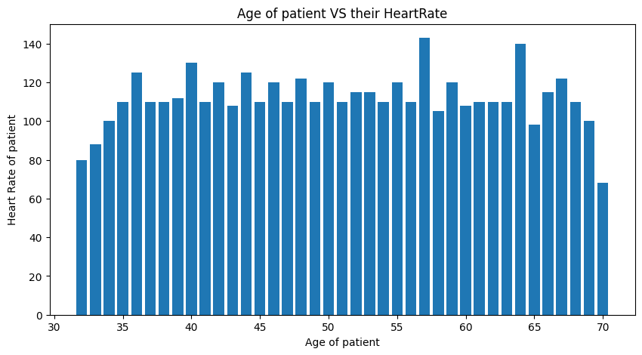
Preprocessing:
• This is a crucial step in data analysis which prepares raw data for further analysis and modeling.
• An effective way to handle these missing values is by filling them with the median value of each column.
•Certain columns like TenYearCHD, is_smoking, and education are dropped because they provide unnecessary information.
Data visualization:
• Libraries such as matplotlib and seaborn have been used.
• Matplotlib is used for generating charts and plots.
• Seaborn is built on top of matplotlib and is a library that is used to make complicated statistical visuals easier to create and understand.
• A bar plot has been created in order to compare the Age vs. Heart Rate of the patient.

Slide 17
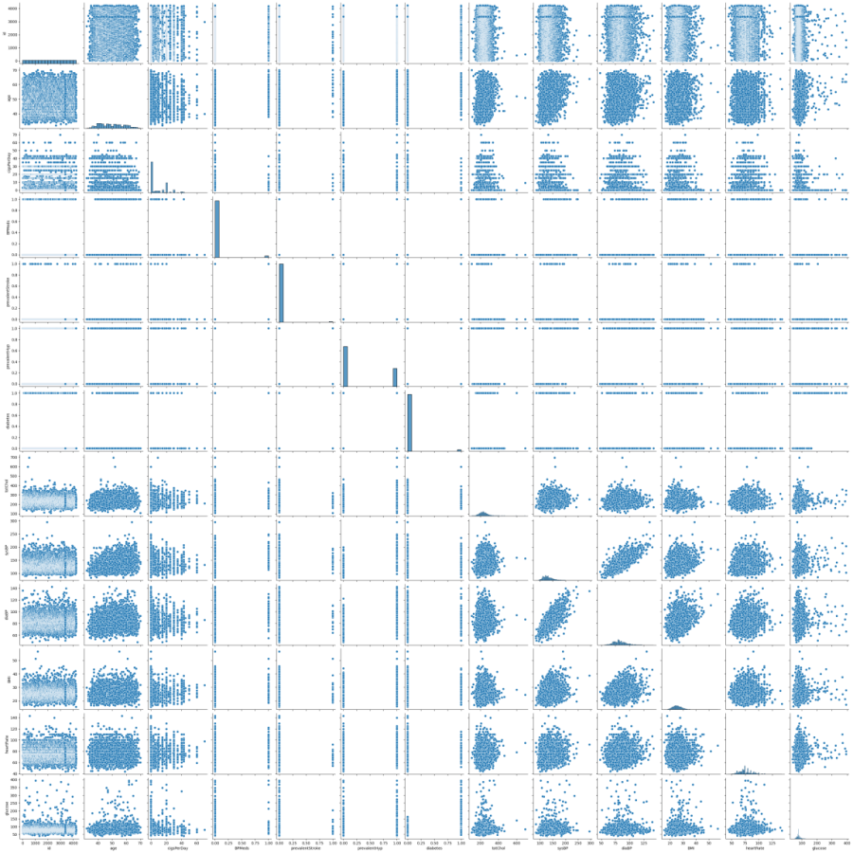
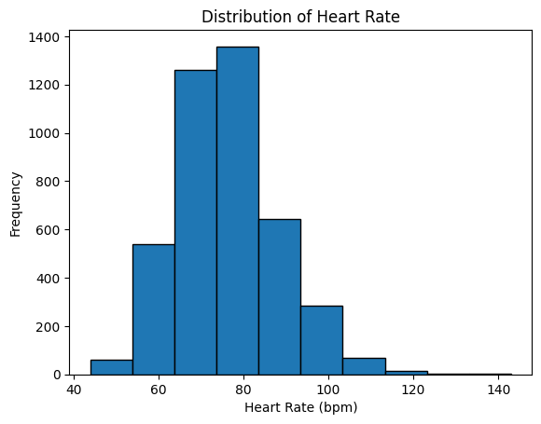
A Histogram has been created for checking the distribution of Heart Rates across various Frequencies.
A pair plot has also been created to show the relationships between variables in the dataset.

Slide 18
Training and Testing:
Before training the model, the data has to be split into two subsets: training data and testing data.
In most cases, about 70-80% of the data is used for training. And the remaining 20-30% is used for testing. In our project, we have utilized 70% of the data for training and 30% for testing in order to prevent over fitting.
During training, the model is fed data from which it learns patterns. The input data contains features such as :
Age
cigsPerDay
BPMeds
prevalentStroke
prevalentHyp
Diabetes
totChol
sysBP
9. diaBP
10. BMI
11. heartrate
12. Glucose.

Slide 19
Once the training is done, the model is tested on new, unseen data. The model makes predictions and the results are compared to the actual outcomes to evaluate its performance.
The testing phase is crucial because it makes sure that the model is not just memorizing the training data but also making accurate predictions on new unseen data.
Models:
The models that we have used in our backend are Logistic Regression, Decision Tree and Random Forest.
Logistic Regression: This is used to predict if the patient has heart diseases or not. ‘1’ if the patient has heart diseases and ‘0’ if the patient does not have heart diseases based on features such as Age and cholesterol.
Decision Tree: This is a flowchart which is used to make decisions based on different features.
Random Forest: An ensemble method that combines multiple decision tress instead of just one to make an accurate and stable prediction.

Slide 20
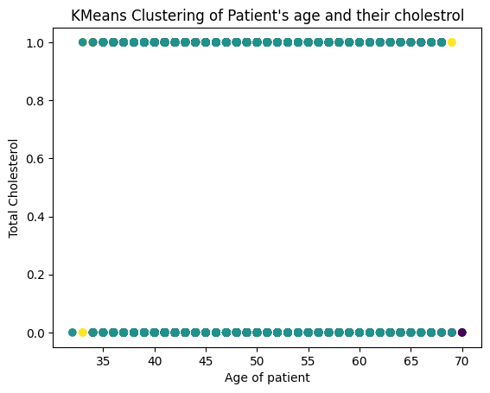
Clustering:
Clustering is a method in data analysis that groups similar objects or data points together.
In our project, we have implemented K-means clustering, a well-known ML method used to divide data into a number of groups.
A scatter plot is made with patient age on the x-axis and cholesterol levels on the y-axis, and the points are colored based on their cluster.
Silhouette score:
The Silhouette Score checks how well data points are grouped together by calculating the score for different numbers of clusters using K-Means.
It compares how similar each point is to its own group compared to other groups and prints the score for each number of clusters to help us choose the best one.
Higher score means the groups are clear and better formed.

Slide 21
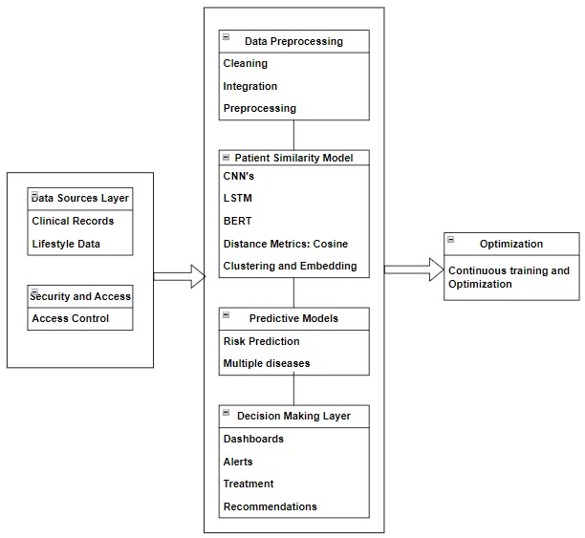
Architecture
Data Source Layer:
Collect patient data and split it into two parts: one to train the model and another to test the model.
Key feature: Keeps data secure and only allows authorized access.
Exploratory Data Analysis (EDA):
Prepares the data and finds useful insights.
Fixing problems in the data, like missing information.
Creating simple charts (like bar charts, histograms, and pair plots) to understand patterns.
Patient Similarity Model:
It groups patients who are similar to each other.
Uses tools like:
Neural networks (CNN) for analyzing complex data.
Simple models (Logistic Regression, Decision Trees).
Clustering (K-Means) to create groups.

Slide 22
Predictive Models:
It predicts what might happen to a patient (e.g., risks or outcomes).
Uses advanced models like:
Neural networks and Random Forests for predictions.
Scores (Silhouette and Similarity) to measure accuracy and patient matching.
Decision-Making Layer:
Helps doctors with clear, actionable outputs.
Easy-to-read visual summaries.
It notifies about critical events.
Optimization:
It continuously improves the models by retraining them with new data to make better predictions over time.

Slide 23
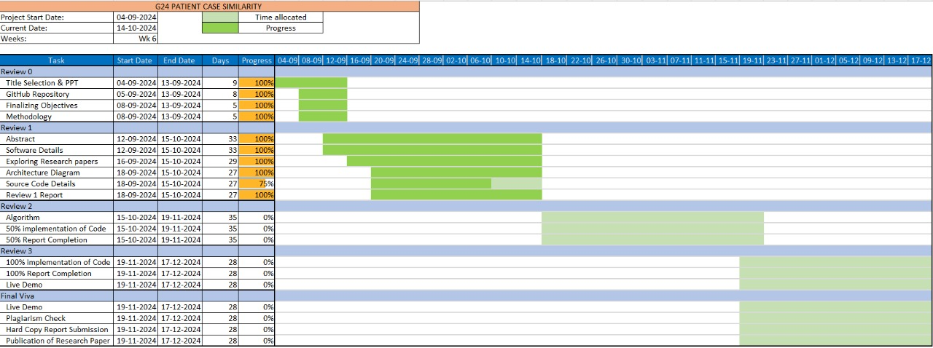
Timeline of Project

Slide 24
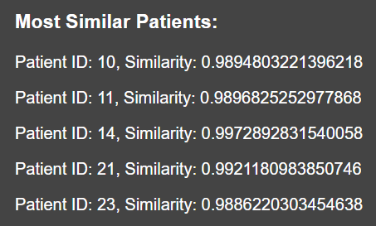
Expected Outcomes
Patient Case Similarity Model gives a similarity score of a new patient by referring to the historical data of an old or existing patient.
In our project, we have determined the similarity score between a new patient and the five most similar patients in the historical data.
This outcome is to bring more substantial improvements in the healthcare management.
The similarity score determines how closely their cases align, with values approaching 1 representing higher similarity.

Slide 25
Results
The dataset “test.csv” and “train.csv” were merged for data analysis and modeling.
Missing values in columns such as cigsPerDay, BPMeds, totChol, BMI, heartRate, glucose, were filled with their median values.
Valuable insights were gained from visualization. A bar chart showed the relationship between age of patients and their heart rates. Histogram showed a normal distribution of heart rate values. Pairwise relationships between numeric variables were visualized using pair plot.
Logistic Regression gave an accuracy of 85.84%, Decision Tree Classifier gave an accuracy of 75.42% and Random Forest Classifier gave an accuracy of 85.05%.
K-Means clustering grouped patients together based on their features and for these clusters a Silhouette score was determined.
We have successfully determined the similarity score of a new patient in comparison to five patients from the historical data.

Slide 26
Conclusion
The project "Patient Case Similarity" has successfully been used to demonstrate the power of Machine Learning in order to enhance clinical decision support systems.
It shows how ML systems can assist doctors in making more accurate diagnoses and predicting health outcomes.
Using historical data, the project has created an easy-to-use web application that looks at patient information, finds patterns, and predicts results by comparing current cases with similar past ones.
The system employs powerful Machine Learning models, including Logistic Regression, Decision Tree, and Random Forest Classifiers. Among all these, the Logistic Regression model was the most reliable for prediction.
The K-Means clustering method grouped patients with similar characteristics, and the results were supported by strong silhouette scores.
The project also used visual tools like bar charts, histograms, and pair plots to provide useful insights into how different factors are related, improving the analysis.
Furthermore, the system demonstrated its precision and adaptability by accurately calculating similarity scores for new patients compared to historical cases.

Slide 27
Github Link
Patient Case Similarity

Slide 28
References
Use abstracted patient-specific features to assist an information-theoretic measurement to assess similarity between medical cases – 2008: https://www.sciencedirect.com/science/article/pii/S1532046408000440
Patient Similarity: Emerging Concepts in Systems and Precision Medicine – 2016: https://www.frontiersin.org/journals/physiology/articles/10.3389/fphys.2016.00561/full
Patient similarity for precision medicine: A systematic review – 2018: https://doi.org/10.1016/j.jbi.2018.06.001
A patient-similarity-based model for diagnostic prediction – 2019: https://doi.org/10.1016/j.ijmedinf.2019.104073
Measurement and application of patient similarity in personalized predictive, modelling based on electronic medical records – 2019: https://doi.org/10.1186/s12938-019-0718-2
Measuring Patient Similarities via a Deep Architecture with Medical Concept Embedding – 2019: https://arxiv.org/pdf/1902.03376
Patient-Case Similarity – 2020: https://www.researchpublish.com/upload/book/Patient%20Case%20Similarity-8606.pdf
Patient similarity: methods and applications – 2020: https://arxiv.org/pdf/2012.01976
Patient similarity analytics for explainable clinical risk prediction – 2021: https://bmcmedinformdecismak.biomedcentral.com/articles/10.1186/s12911-021-01566-y
A Novel Patient Similarity Network (PSN) Framework Based on Multi-Model Deep Learning for Precision Medicine – 2022: https://doi.org/10.3390/jpm12050768
Deep Dynamic Patient Similarity Analysis: Model Development and Validation in ICU – 2022: https://www.sciencedirect.com/science/article/pii/S0169260722004151
Patient Case Similarity - 2024: https://www.doi.org/10.56726/IRJMETS48246

Slide 29
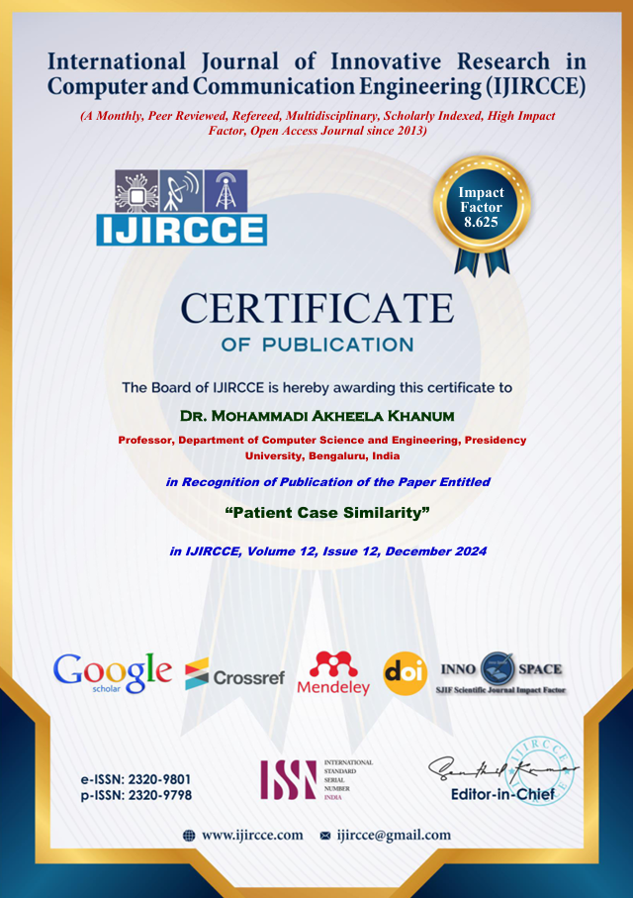
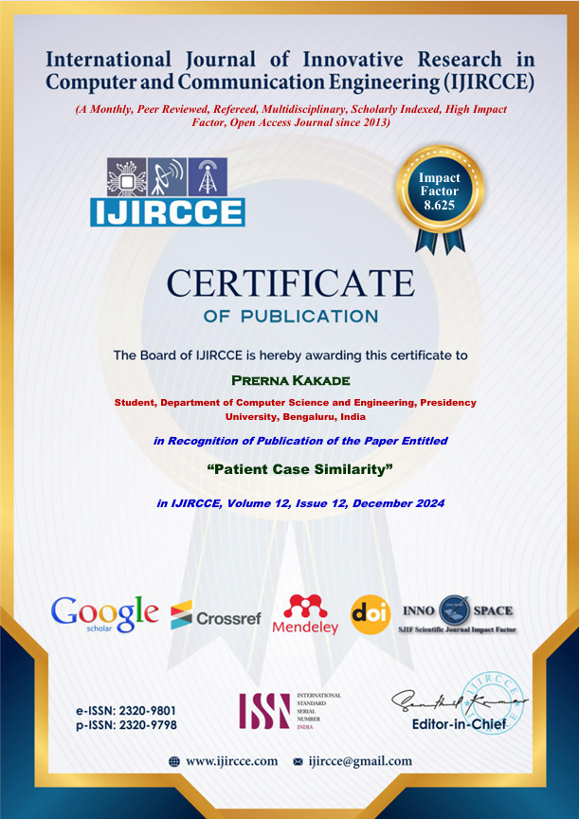
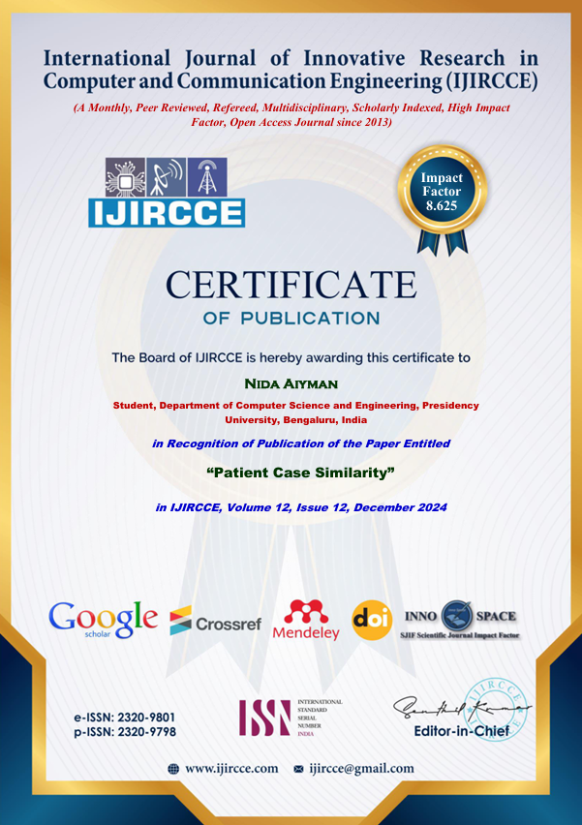
Publication Proof

Slide 30
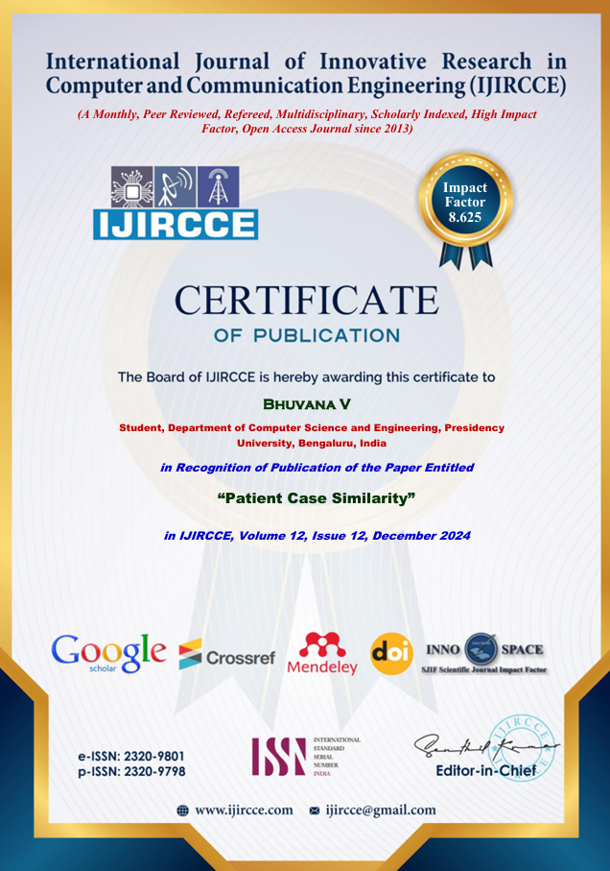


Slide 31
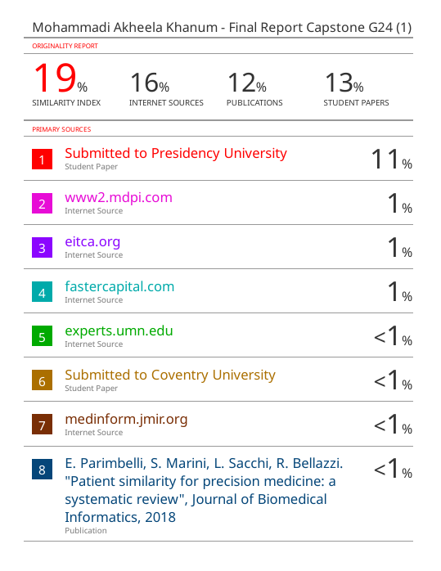

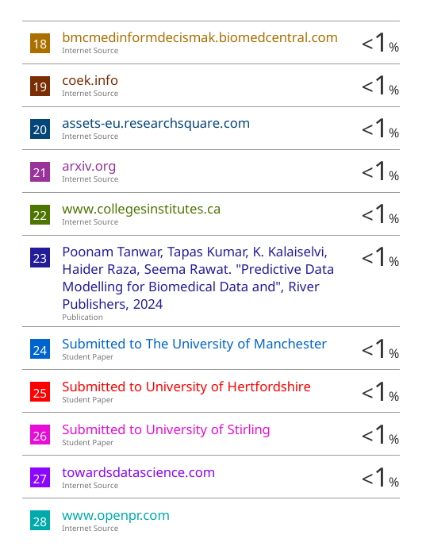
Plagiarism Check

Slide 32
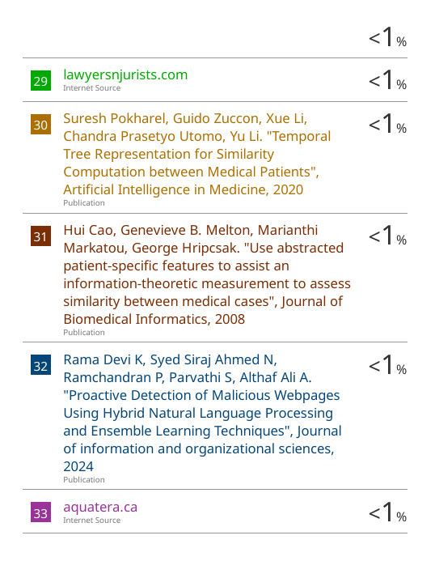


Slide 33

Project work mapping with SDG
Our project is mapped to SDG-3,that is, Good health and Well Being.
Our main goal is to cluster patients based on heart diseases, diabetes and other diseases and give similarity scores between historical and new patients.
This will help in improving the diagnostic accuracy, predictive models and optimize the models.

Slide 34
Thank You

